Slide 1
Social Distance Detection App
Dharmsinh Desai University,Nadiad
By Devansh Maru,Gaurav Mori,Vedant Panchal

Slide 2
Todays Covid -19 situation in world

Slide 3
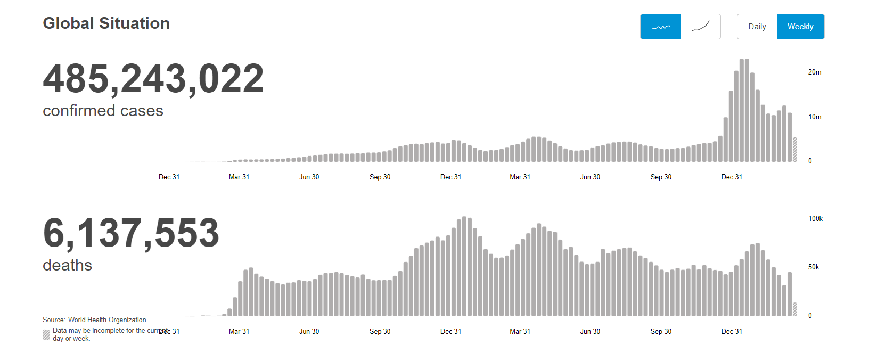
According to WHO (1 april,2022)

Slide 4
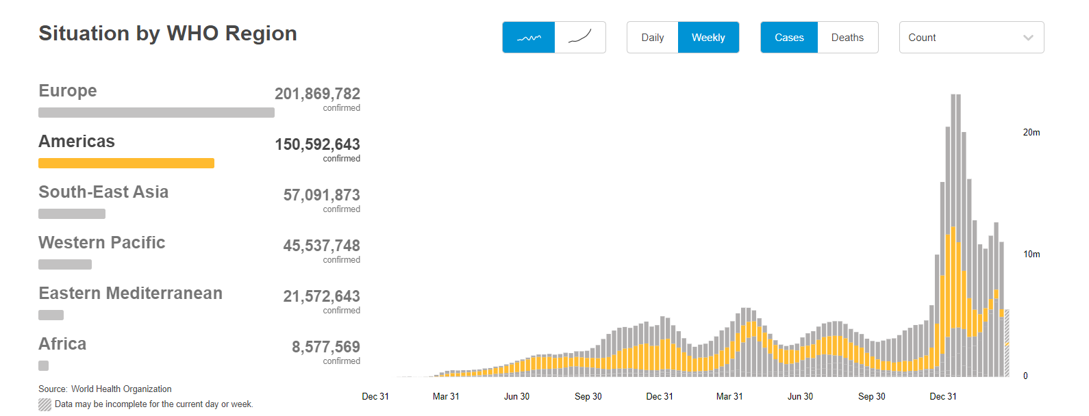
According to WHO (1 April,2022)

Slide 5
Today,why we need to maintain Social Distance?

Slide 6
Social distancing is a non-pharmaceutical infection prevention and control intervention implemented to avoid/decrease contact between those who are infected with a disease causing pathogen and those who are not, so as to stop or slow down the rate and extent of disease transmission in a community. This eventually leads to decrease in spread, morbidity and mortality due to the disease.

Slide 7
Our Project
Social Distance Detection App

Slide 8
What our web App Does?
Detect the person in given frame.
Show the total number of person detect in frame.
Show the total number of violation.
Show green , red and yellow boxes according to Social Distance.

Slide 9
Procedure/Steps
Select Video From your computer and submit via web page.
In backend our model is running and analyze all parameters.
Then on the screen the final output frame is shown in which all data is displayed.

Slide 10
Implementation Details

Slide 11
● Backend :
Python : In python language we used deep learning for
backend purpose.
● Frontend : Django framework : For frontend purpose we use
django framework to take video input file.
● Tools : 1) Github
2) Visual studio code
Tools / Technologies

Slide 12
Implementation Details
In Backend we use pre trained model YOLO V3.
YOLO (You Only Look Once) is a method / way to do object
detection. It is the algorithm /strategy behind how the code is
going to detect objects in the image/video.
Using COCO’s pre-trained weights means that you can only use YOLO for object detection with any of the 80 pretrained classes that come with the COCO dataset.
We use only person entity for our purpose.

Slide 13
Glimpse of our Project

Slide 14


Slide 15
Conclusion
A deep learning-based social distance monitoring framework is presented using an overhead perspective. The pre-trained YOLOv3 paradigm is used for human detection.
The detection model gives bounding box information. Using the Euclidean distance, the pairwise centroid distances between detected bounding boxes are measured. To check social distance violations between people, an approximation of physical distance to the pixel is used, and a threshold is defined.

Slide 16
Limitations
System is not working for direct live cctv camera.
The tracking accuracy of peoples is quite lesser.

Slide 17
Future Enhancements
The work may be improved in the future for different indoor and outdoor environments.
The system also works for live cctv camera footage.
Different detection and tracking algorithms might be used to help track the person or people who are violating or breaches the social distancing threshold.
More accuracy for detecting peoples.
More accuracy for checking violations.

Slide 18
Thank you

